Slide 1
Business Insights 360
With Power BI

Slide 2
Finance View
KPI Analysis: Comparison of Net Sales, Gross Margin %, and Net Profit % against the previous fiscal year.
Segment & Market Trends: YoY growth and percentage change in Net Sales across segments and markets.
Financial Summary: Comprehensive table presenting key financial metrics for detailed analysis.
Performance Trends: Line charts visualizing financial metrics over time for trend analysis.

Slide 3
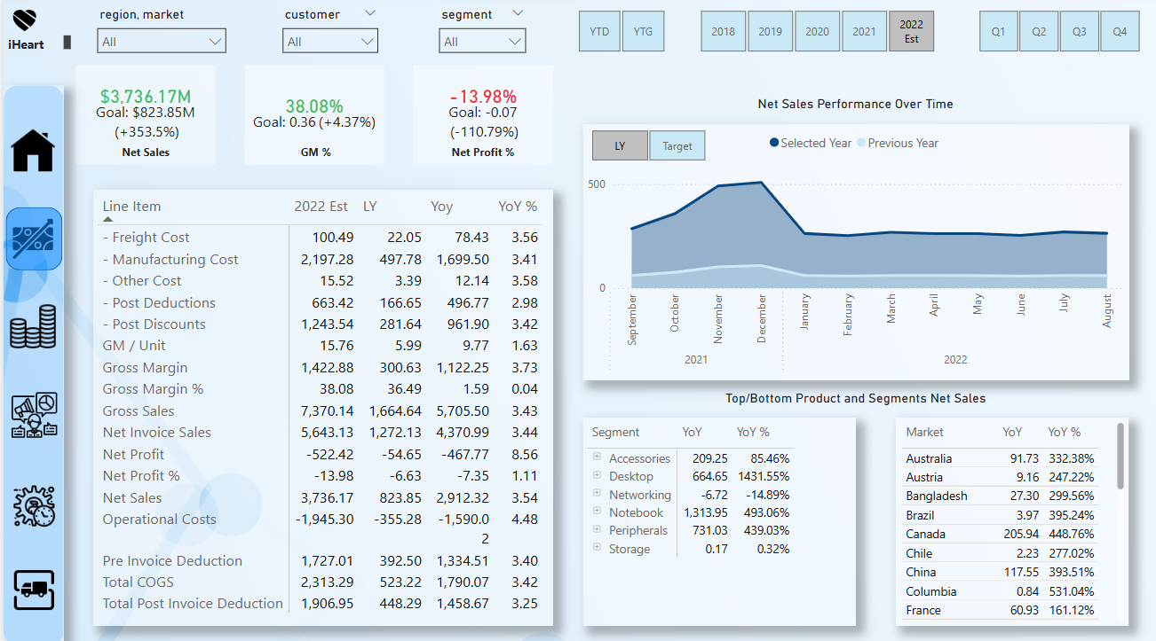
Finance View

Slide 4
Sales View
Customer & Market Performance: Detailed analysis of sales trends across customers and markets.
Revenue & Profitability Insights: Comparative evaluation of Net Sales and Gross Margin %.
Cost & Deductions Overview: Distribution of key cost components impacting overall profitability.
Sales Contribution Analysis: Identification of high-performing customers and markets driving revenue.
Trend Evaluation: Insights into sales growth patterns and profitability fluctuations over time.

Slide 5
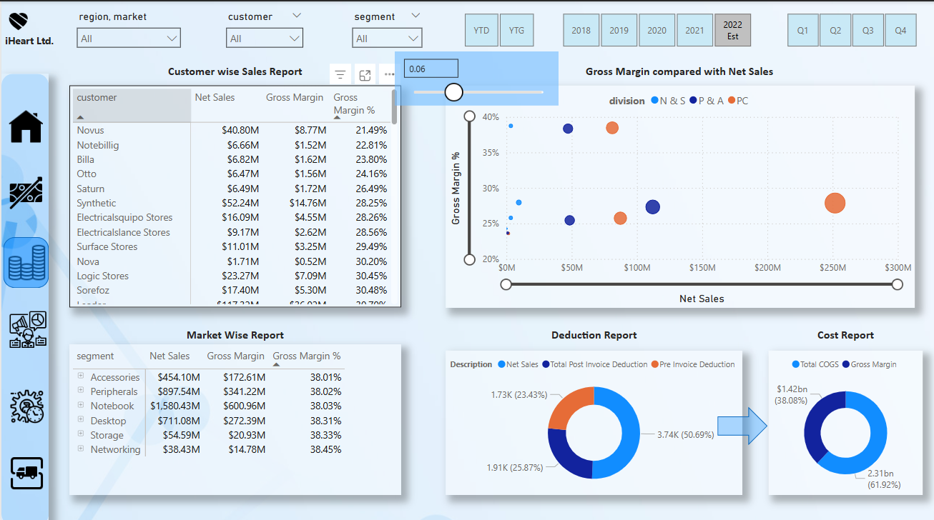
Sales View

Slide 6
Marketing View
Profitability Analysis: Evaluation of Net Profit after marketing deductions across segments and regions.
Marketing Impact on Revenue: Assessment of how marketing expenses influence overall profitability.
Segment & Regional Performance: Comparative analysis of Net Profit across different markets.
Cost Efficiency Insights: Review of marketing expenditures in relation to revenue contribution.
Trend & Variance Analysis: Tracking changes in Net Profit over time to identify key drivers.

Slide 7
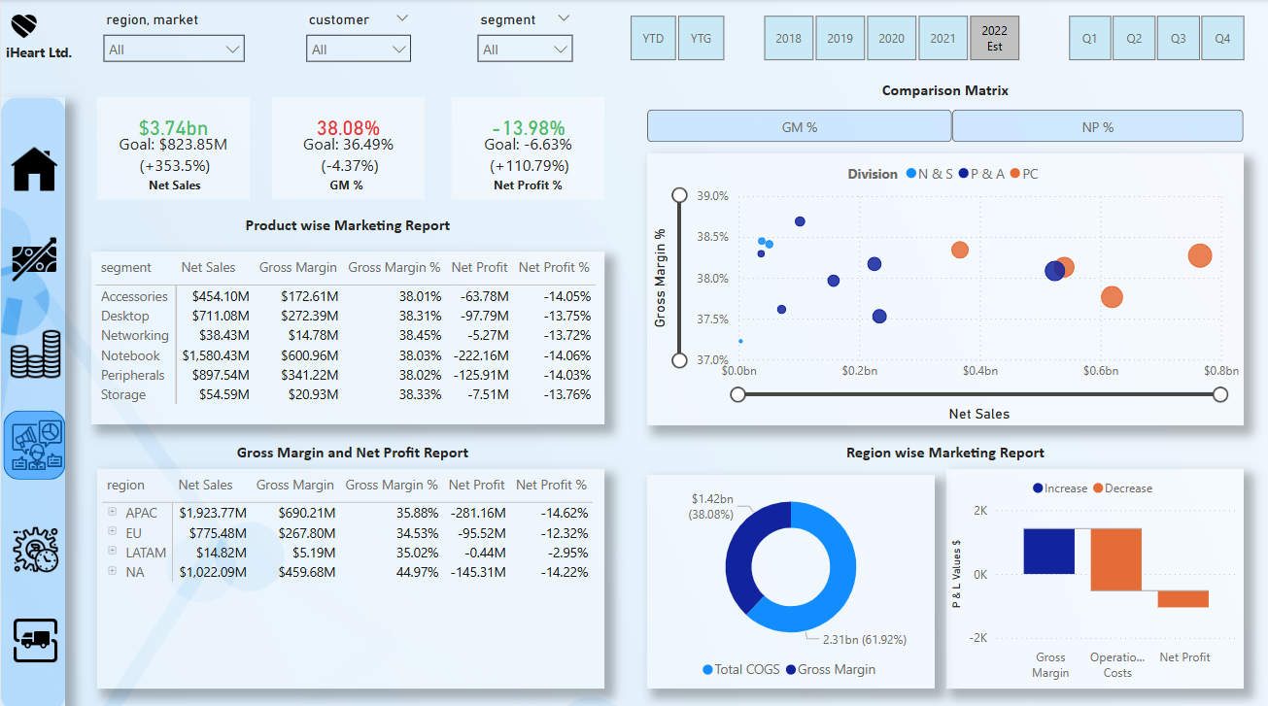
Marketing View

Slide 8
Supply Chain View
Error Analysis: Evaluation of Net Error and Absolute Net Error to measure supply chain accuracy.
Stock Availability Insights: Identification of out-of-stock and surplus products across categories.
Demand-Supply Balance: Assessment of inventory efficiency in meeting market demand.
Operational Performance: Analysis of supply chain discrepancies and their impact on fulfillment.
Trend Monitoring: Tracking stock fluctuations over time to optimize inventory management.

Slide 9
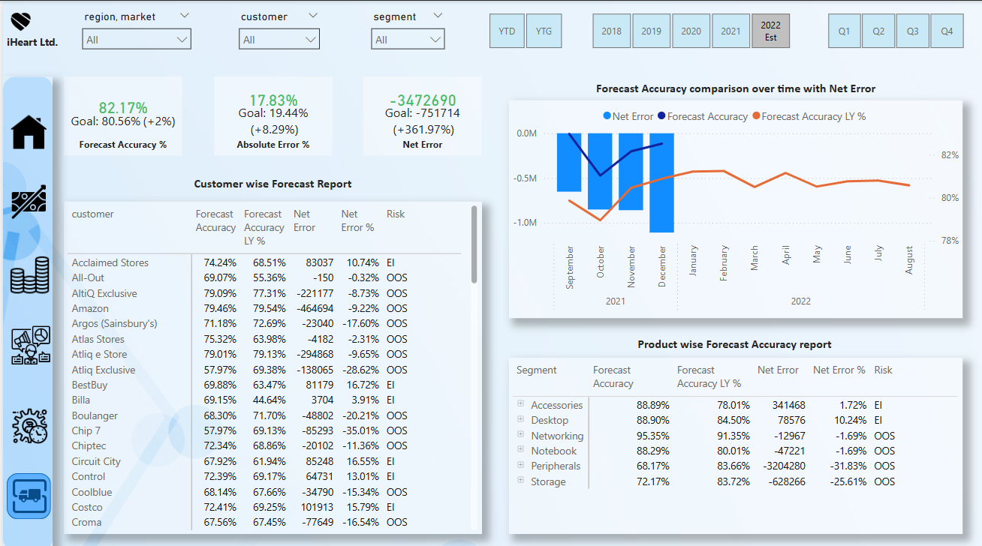
Supply Chain View

Slide 10
Executive View
Business Performance Overview: High-level analysis of revenue, net sales, and profit trends.
Revenue Contribution Insights: Breakdown of key segments driving overall business growth.
Profitability Assessment: Evaluation of net profit and margins for strategic decision-making.
Market & Segment Trends: Performance comparison across different markets and business units.
Year-on-Year Comparison: Analysis of growth trends and financial performance over time.

Slide 11
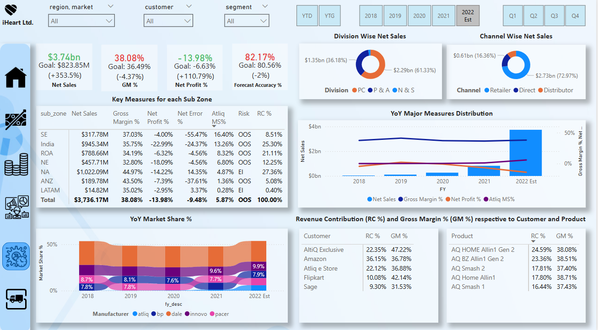
Executive View

